Slide 1

EXCEL · CLEANING
POWER BI
104
DATA ANALYTICS PROJECT DEFENSE
Merson's Recruitment & Employee Attrition Analytics
employees terminated
out of 311 records
33.4%
Which hiring channels build a lasting workforce, and why do people leave?
overall attrition rate
Ayoola Enoch Ayo-oni
Wetin Dey Code Academy · September 2026
Notes:
Introduce the project: Excel for cleaning, Power BI for transformation, DAX and dashboards.

Slide 2

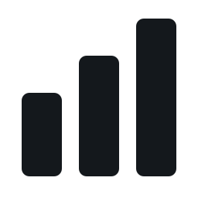


The workflow, end to end
Two tools, one pipeline from raw HR data to decisions.
01
02
03
04
EXCEL
POWER BI
POWER BI
INSIGHTS
Clean
Transform
Visualise
Recommend
Headers, blanks, duplicates, labels
Import, model, 9 DAX measures
2 dashboards, 5 objective views
Findings and HR actions

Slide 3






01
Introduction
Merson is a North American metals processing and manufacturing company serving customers across many industrial sectors through an extensive network of facilities.
A DIVERSE WORKFORCE
Production
Engineering
Sales
This analysis surfaces workforce patterns to support data-driven HR decisions on hiring channels and retention.
Admin
IT
Management

Slide 4
02
Data source & overview
312
19
Salary
Position
Department
RecruitmentSource
PerformanceScore
rows
columns
EmploymentStatus
TermReason
Source: Kaggle.com HR dataset, 311 employee records analysed
EmpSatisfaction
DateofHire
DATA LIMITATIONS
DateofTermination
Absences
1
Snapshot of one period; may not reflect today
2
No recruitment cost or time-to-hire data
3
No qualitative detail behind each exit
4
Performance is categorical, not continuous

Slide 5
03
Objectives & questions
1
Performance across recruitment sources
GUIDING QUESTIONS
How do sources differ in performance, retention and satisfaction?
How does attrition vary across sources and departments?
What are the major termination reasons, and which are largest?
2
Attrition patterns by recruitment source
3
Reasons for termination; main drivers
4
Attrition by department
5
Retention, performance and satisfaction by source

Slide 6
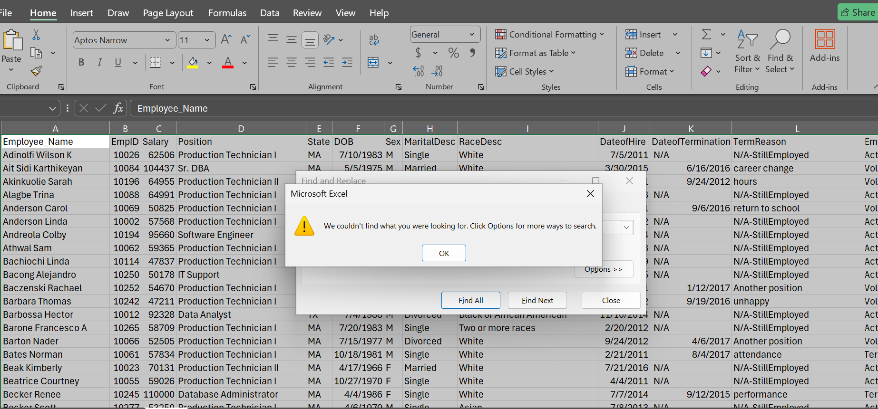
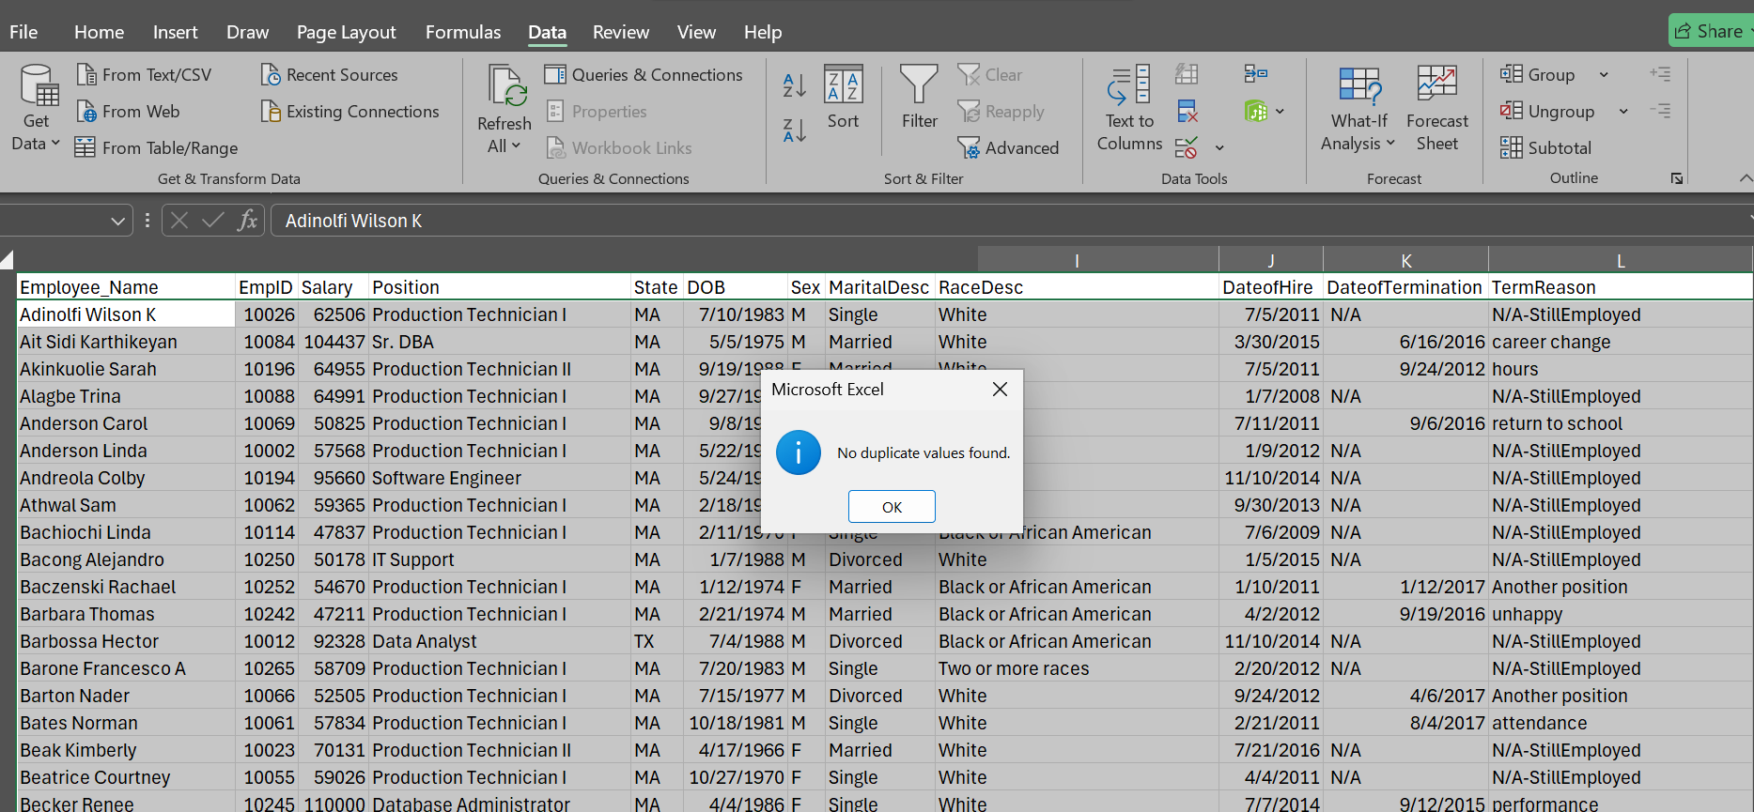
No blank cells found
STAGE 1
Cleaned in Microsoft Excel
1
Headers EmpID to EmployeeId, DOB to DateofBirth, TermReason to TerminationReason
No duplicates found
2
Blanks Find & Replace found none
3
Duplicates Remove Duplicates found none
4
Labels M to Male (135), F to Female (176)
Evidence from the Excel cleaning steps

Slide 7

DAX MEASURES
Total Employees
Active Employees
COUNT( )
COUNT( )
STAGE 2
Transformed in Power BI
Terminated Employees
Voluntary Terminations
CALCULATE( )
CALCULATE( )
The cleaned Excel data was imported into Power BI, where nine DAX measures were created to power every KPI, chart and dashboard.
Attrition Rate
Retention Rate
DIVIDE( )
CALCULATE( )
Average Satisfaction
Exceeds Expectations
AVERAGE( )
CALCULATE( )
Exceeds Percentage
CALCULATE( )

Slide 8
POWER BI · OBJECTIVE 1
Performance varies by recruitment source
20.7%
of Diversity Job Fair hires Exceed Expectations
Employee Referral is next at 16.1%
Indeed and LinkedIn, the largest channels, produce below-average top performers
Google Search is lowest at 4.1%
Notes:
Share of hires rated Exceeds Expectations, by source.

Slide 9
POWER BI · OBJECTIVE 2
Terminations cluster in a few channels
30
terminations from Google Search, the most of any source
Indeed (21) and LinkedIn (18) follow
Employee Referral lost only 5
Website, Online Web Application and Other lost 1 each
Notes:
Terminated employee counts by recruitment source.

Slide 10
POWER BI · OBJECTIVE 3
Why employees leave
59.6%
of all 104 exits come from the top five reasons
Another position (20), Unhappy (14), More money (11), Career change (9), Hours (8)
Largely voluntary and preventable
Performance-related exits: only 4
Notes:
Top five reasons account for 59.6% of the 104 terminations.

Slide 11
POWER BI · OBJECTIVE 4
Attrition peaks in two departments
39.7%
attrition rate in Production, the highest department
Software Engineering follows at 36.4%
Sales is lowest at 16.1%
Production is also 67% of the workforce (209 of 311)
Notes:
Attrition rate by department.

Slide 12
POWER BI · OBJECTIVE 5
Retention differs sharply by source
92.3%
of Website hires are still active
Employee Referral 83.9% and LinkedIn 76.3% retain well
Google Search 38.8% and Diversity Job Fair 44.8% are weakest
Online Web App is a single hire (0% active)
Notes:
Active share of hires by recruitment source.

Slide 13
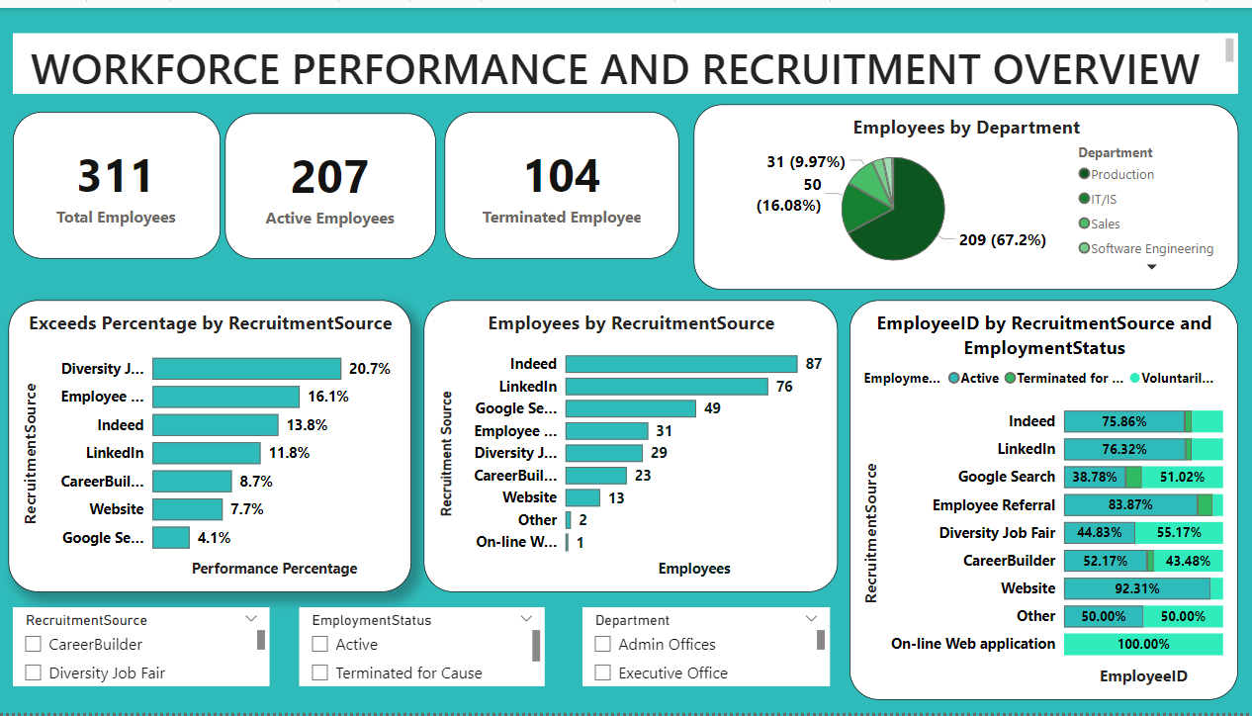
POWER BI DASHBOARD
Workforce & Recruitment Overview
311 employees: 207 active, 104 terminated
Production is 67.2% of the workforce
Indeed (87) and LinkedIn (76) lead hiring
Slicers: source, status, department
Interactive slicers let HR filter every visual.

Slide 14
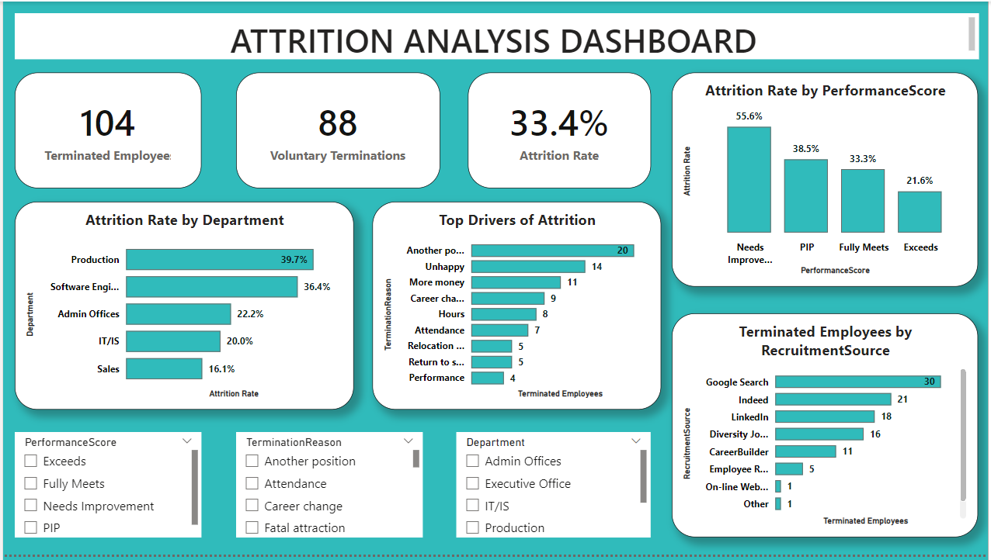
POWER BI DASHBOARD
Attrition Analysis
104 terminated, 88 voluntary
Attrition rate: 33.4%
Needs Improvement staff leave most (55.6%)
Exceeds performers leave least (21.6%)
Interactive slicers let HR filter every visual.

Slide 15
07
Conclusion
33.4%
of employees were terminated: 104 of 311 records
59.6%
of exits come from five largely voluntary reasons
>50%
of the workforce was hired through Indeed and LinkedIn
Attrition is uneven: Production, Software Engineering and channels like Google Search drive it. Source, performance, department and status together shape workforce outcomes.

Slide 16
08
Recommendations
1
Rebalance sourcing
Keep Indeed and LinkedIn as core; shift budget toward Employee Referral and Website
2
Review weak channels
Audit Google Search and Diversity Job Fair; focus on early-tenure onboarding support
3
Target exit drivers
Improve engagement, career paths, pay reviews and exit interviews, starting in Production
4
Manage performance
Coach low performers; recognise, develop and reward top performers
5
Decide with outcomes
Use retention, performance and satisfaction when choosing recruitment channels

Slide 17




EXCEL · CLEANING
POWER BI
Thank you
Questions & discussion
ayoolaoni09@gmail.com
07036127122
linkedin.com/in/AyoolaAyooni
github.com/OAAlago

